Slide 1
State Exams 2024

Slide 2
St. Peter’s College only facilitates the exams happening, we have no control over superintendents, reasonable accommodations or any other issues that may arise on the day

Slide 3
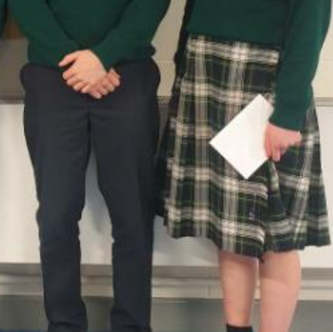
Junior Cycle Students
All Junior Cycle students must present in FULL school uniform (not PE gear), including footwear and school jacket

Slide 4
Leaving Cert Only
Based on last years information there will be deferred exams for Leaving Cert students for
(i) bereavement
(ii) serious illness
We are awaiting confirmation of this for this year

Slide 5
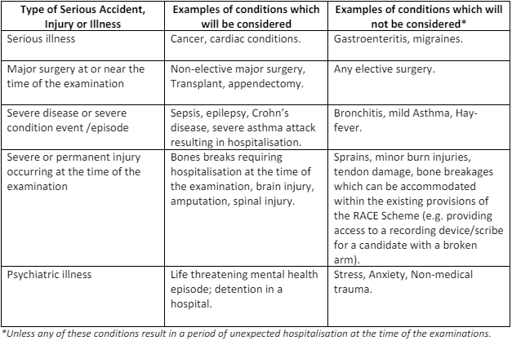

Slide 6
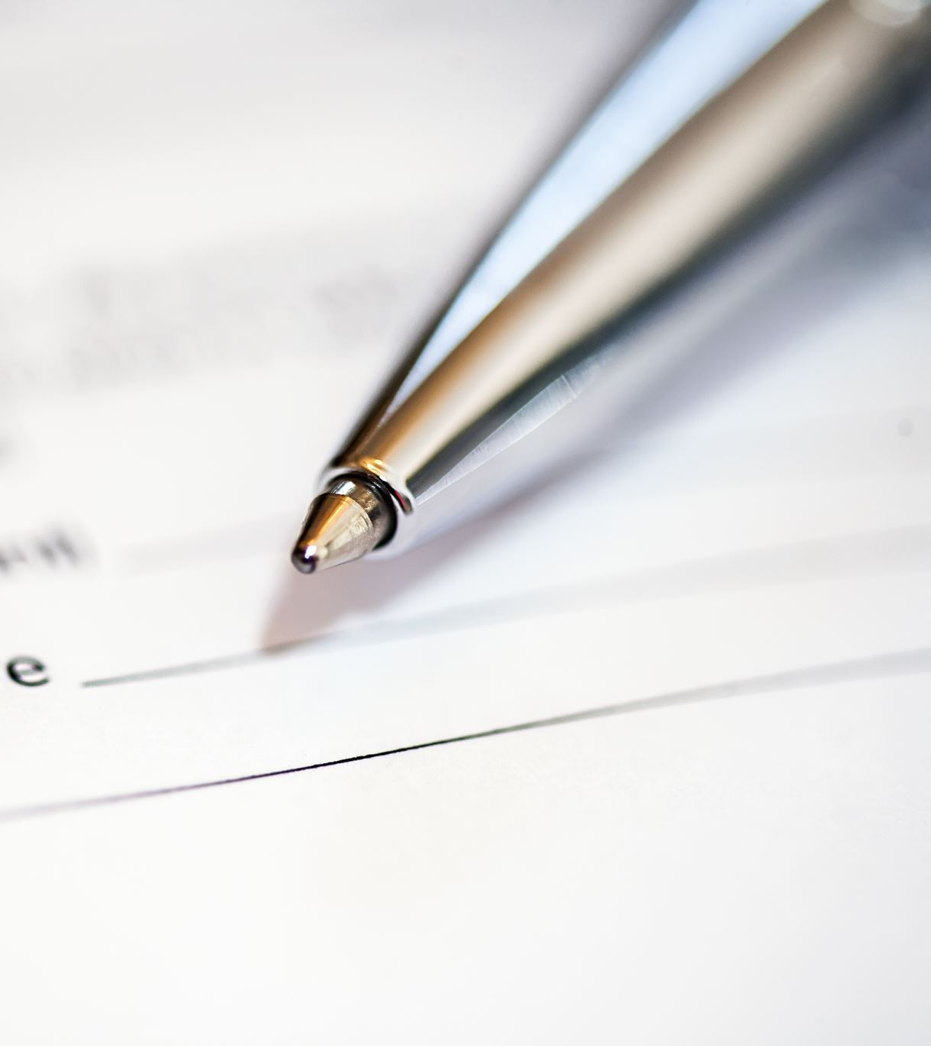
Reasonable Accommodations
If you are unwell on the day of the exam you are not entitled to a special center, reader, scribe etc. You have 2 choices
1. Come in and do the exam as normal
2. Miss the exam

Slide 7
In Exceptional circumstances you may be entitled to rest breaks ,not exceeding 20 minutes per examination. A need for rest break must be supported by a doctor's note that must be given to the school prior to the exams
The total of the rest break(s) granted by the school must not exceed 20 minutes per examination
Candidates are not permitted to read, write or complete any other examination related activity during the rest break — rest breaks do not represent additional time in which to complete the examination. The clock is effectively stopped, and the time is added at the end of the examination
The candidate will be accommodated in the main examination centre and rest breaks must be supervised.

Slide 8
In EXCEPTIONAL ( hospitalization, broken arm) circumstances Late reasonable accommodations may be allowed. This is all the discretion of the SEC not the school.
If something like this does arise you need to contact the school ASAP. You need to go to a doctor and get a doctor's note to say you are unable to write etc BEFORE you get to school.
A form needs to be filled out by you (and a parent if you are U18) that has to be sent to SEC where a decision will be made. This is not a guarantee. Any time missed sorting this out may not be given at the end of the paper.

Slide 9
Direct Communication from SEC
The State Examinations Commission (SEC) would like to remind you that the closing date for the receipt of late applications for Reasonable Accommodations at the Certificate Examinations (RACE) for Leaving Certificate, Leaving Certificate Applied and Junior Cycle has now passed and the emergency application will be available on our website at the link below from the beginning of May 2023.
The SEC expect that this application will only be used for actual emergencies that arise between now and the examinations in June and the SEC retains the right to decide what an actual true emergency is, e.g. broken limb, etc.

Slide 10
Late Reasonable Accomadations Application

Slide 11
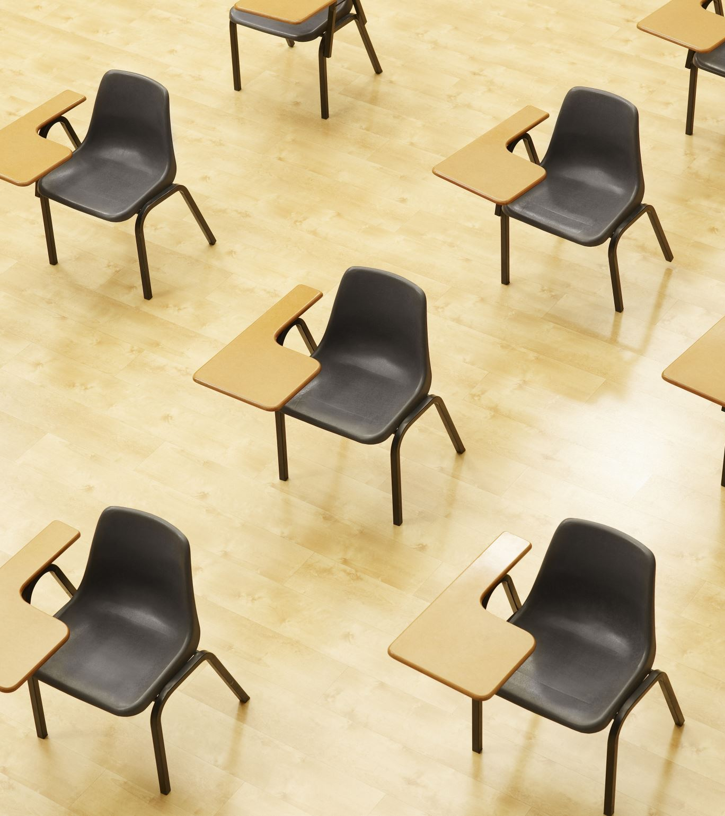
All students must present to the exam center 30 mins before their first exam. After that you must be in the exam hall 15 mins before the exam.
Some superintendents may not allow lucozde etc into the exam hall. That is at their discretion. If you need sweets (e.g. you are diabetic) it is important to let school know so they can inform the superintendent.

Slide 12
You will not be permitted to leave the exam room within the first 30 mins or last 10.
If you are more than 30 mins late for the exam you will not be allowed to enter the exam. There is nothing the school can do in this case. PLEASE ensure to be on time and plan properly if you depend on public transport etc. to get you to school
If you decide NOT to sit any papers, please let the school know ASAP. We have a limited time to contact students who may have genuinely missed the start of the exam, the smaller the number we need to contact the better chance we have of contacting a student who needs it.

Slide 13
Breach of Regulations
Where a candidate is found violating the Rules laid down for the conduct of the examinations, such as having any books, electronic devices or notes in his/her possession, obtaining aid from, or giving aid to another candidate etc., they will be warned that the alleged violation is being reported to the SEC and that his/her examination may be disallowed.
The superintendent's role is to report every incident, not determine whether or not the incident is or is not a potential breach of Regulations.

Slide 14
Mobile Phone/ Electronic Equipment
DO NOT bring your mobile/smart watch etc into the exam, even if it is switched off. There are door attendants on each door to supervise bags etc.
If an examiner SEES a mobile on your person in the exam they are entitled to record it as breach.
The superintendent is entitled to take your phone, SIM and PIN and send to the SEC for investigation. Refusal to do so will have a effect on your ability to continue exams.

Slide 15
Levels
All the exams that you are doing, and the level is recorded on a sheet outside each exam room door. If you notice any issues with a subject or level, please let your Superintendent and School Exam Aides
Very little can be done after the exam if there is an issue.
Once you open a paper you can not change level.

Slide 16
Be Prepared
You are not allowed share equipment on the day of the exam.
The school will not be able to provide you with any equipment.
Log tables are provided on the day

Slide 17
Return of Books
Please bring all school books (not exam papers) on the day of each exam to return to the school. They will be collected by the exam attendant.

Slide 18
Best Of Luck!
Ms McGovern and Ms Ni Mhaile are the school's exam aides and will be available on the days of the state exams. They will be in the student office from 8:30 every morning so if there are any issues, find me there and hopefully we can sort all out

