Slide 1
Welcome to St. Peter’s College
28th May 2024

Slide 2
Principal Deirdre Maye
Deputy Principals Brian McNamara
Siobhan Synan
Leonora Acton
Ceannairí Marie Louise McElroy
(Year Heads) Aideen Flood

Slide 3
Wellbeing - Student Supports
Guidance Brian McCarthy Niamh Collins
Chaplain Valerie McParland
SEN Anchor Shauna Coghlan

Slide 4
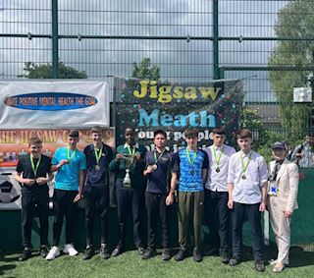
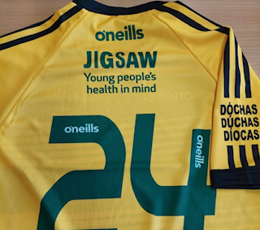

Slide 5
Class Tutor
Every student is assigned to a tutor class
Class is called after the tutor
Tutor is a parent/guardian’s first point of contact
Teachers will liaise with the tutor if they have concerns about a student
Tutors monitor attendance and behaviour

Slide 6
Ceannaire (Year head)
Responsible for overseeing the care and administration of the year group
Support and advise tutors
Organises support for students
Arranges events for the year group
Deals with serious disciplinary matters
Liaises with parents/guardians
Notes:
Student supports – Guidance counselling, pastoral support, learning support
Year group events – workshops/guest speakers e.g. Internet safety, Community Garda visit

Slide 7
Homework
Written, learning and revision homework should be written into the journal for every class, every day.
Start the week with all subjects for every day written into the journal
First year homework guideline:
1 – 1 ½ hours

Slide 8
Uniform
St. Peter’s College, green, round neck jumper, kilt or navy trousers and a white shirt. All students must wear the St. Peter’s College school uniform coat. No other coat is permitted. Black shoes (not runners) must be worn.
Uniforms can be purchased directly from: Leddy Uniforms, Main Street, Blanchardstown, Dublin 15.
All junior students wear the full school PE uniform for PE and all school sports events. New PE uniform for 2024. Original hoodie and polo shirt are also permitted.
PE uniform can be purchased from: Dunboyne Sports & Leisure, Main St, Dunboyne
Compliance with the school uniform policy is essential
Please see the school website for further details on the uniform

Slide 9
Communication with the school
Regularly review your son/daughter’s Compass profile Comments regarding progress, homework and behaviour will be noted on Compass
Notes for absences should be recorded on Compass
If you wish to contact the school, phone or email the school office
Medical concerns – information gathered via Microsoft Form. Please respond with any medical concerns

Slide 10
Start up days
Wednesday 28th August 9.30 am -12.30 pm
Thursday 29th August 8.50 am – 1.05 pm
Friday 30 August 8.50 am – 1.05 pm

Slide 11
School Times
8.30 am Campus opens
8.50 am Classes start
10.50 am Small break (15min)
1.05 pm Lunch break (40min)
3.05 pm Classes finish (Tue/Wed/Fri)
3.45 pm Classes finish (Mon/Thur)

Slide 12
Supporting the transition into St. Peter’s College
New First Years Information booklet
Reduced homework for the first two weeks
Earlier access to lockers and canteen
Monitors and Caomhnoirí assigned to help each first year class
Get Up, Stand Up programme

Slide 13
Helping your son/daughter settle into St. Peter’s College
Read the New First Year Information booklet with them
Encourage your child to join school clubs, teams etc.
Advise them to chat to everyone – classmates, friends of friends, teammates, Monitors, Caomhnoirí and teachers
Reassure your son/daughter that adjusting to a new school takes time

Slide 14
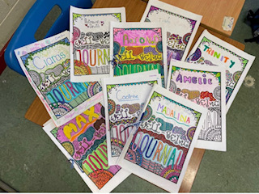
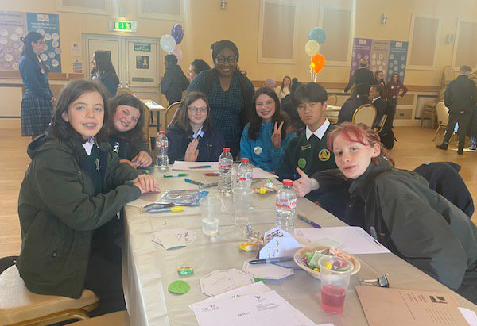

Slide 16
An Chrannóg
St Peter's College –
Autism Class :)

Slide 17
Frequently asked questions
Book rental scheme
Optional subjects
Lockers
Mobile phones/internet enabled watches
Makeup and piercings
Lunch
Punctuality
Leaving early
Feeling ill in school
Notes:
Book rental scheme – text books
Optional subjects
Will be assigned a locker in the first year area. Included as part of the Direct Contribution.
Mobile Phones/Internet enabled Devices
Phones/Internet enabled devices will be confiscated if seen or heard (Acceptable Use Policy)
Junior Students are not allowed leave the campus at break times
Canteen is managed by The Food Village. Students can buy lunch in shop (advance purchase necessary) or bring their own. Healthy food policy – no fizzy or energy drinks permitted.
Students must let the school know if they have forgotten their lunch
Sustainable also – no single use bottles
Late - must be signed with a parent
Non emergency appointments should made outside of school time, where possible
Students must be collected by a parent when signing out
If a student feels ill in school, they should let a teacher know and then go to the school office who will phone home

Slide 18
